Slide 1

Power BI Fraud Detection Project – Presentation Outline

Slide 2



Project Introduction
Title
Context
Goal
Fraud Detection in Electricity and Gas Consumption
Electricity and gas providers face significant losses due to fraudulent activities by consumers.
Develop a machine learning solution to identify potential fraud and provide actionable business insights.

Slide 3
Dataset Information and 🏷️ Sector of Focus
Sector: CybersecurityProblem Statement: (Already Explained)Dataset Title: Fraud Detection in Electricity and Gas Consumption ChallengeNumber of Sataset: 4Source Link: https://zindi.africa/competitions/fraud-detection-in-electricity-and-gas-consumption-challengeNumber of Rows and Columns: test_df ===> (1939730, 20) train_df ===> (4476749, 21)Data Structure: Structured (CSV)Unstructured (Text, Images): N/AData Status: Requires Preprocessing

Slide 4

Methodology
Data Preparation:
Removed irrelevant columns (IDs).
Encoded categorical variables and scaled numeric features.
Modeling:
Utilized RandomForestClassifier for classification.
Split data into training and validation sets.
Evaluated model using accuracy and classification report.
Visualization:
Developed interactive Power BI dashboard for data exploration and insight communication.

Slide 5
Tools & Technologies
Python, Pandas, NumPy
Scikit-learn, XGBoost, LightGBM
Google Colab
Zindi for model evaluation

Slide 6
Evaluation
Submissions are evaluated on Zindi using classification metrics like ROC-AUC. The model's performance will determine the ranking on the leaderboard

Slide 7
Results
Effective fraud analysis in Power BI relies on integrating diverse data sources. This ensures a broad and deep understanding of all potential threats.
1
2
Model Performance
Key Insights
Achieved high accuracy on validation data.
Identified high-risk customer segments and patterns.
Classification report shows precision, recall, and F1-score for each class.
Visual trends and distributions presented in Power BI.
Confusion matrix highlights the model’s ability to distinguish between fraudulent and non-fraudulent cases.

Slide 8
Recommendations
Key Metrics
Visualizations
Failed Login Attempts
Line Charts for Trend Analysis
Fraud Transaction Counts
Maps for Location-Based Anomalies
Geographic Mapping of Suspicious Activities
Tables for Detailed User Risk Profiles
User Risk Scores
Interactive Slicers and Filters
Interactive elements allow dynamic analysis by time, category, or region, empowering deeper investigations.

Slide 9



Recommendations
Prioritize High-Risk Accounts for Inspection
Implement Real-Time Monitoring
Update Detection Models Regularly
Focus audits on accounts flagged by the model.
Set up alerts for suspicious usage patterns.
Retrain and improve models as new data becomes available.

Slide 10
Future Work
Model Enhancements
Deployment
Explore advanced algorithms and feature engineering for improved detection
Integrate the model into real-time utility monitoring systems.
Continuous Learning
Broader Application
Incorporate feedback from detected fraud cases to refine the system.
Extend solution to other regions and utility types

Slide 11
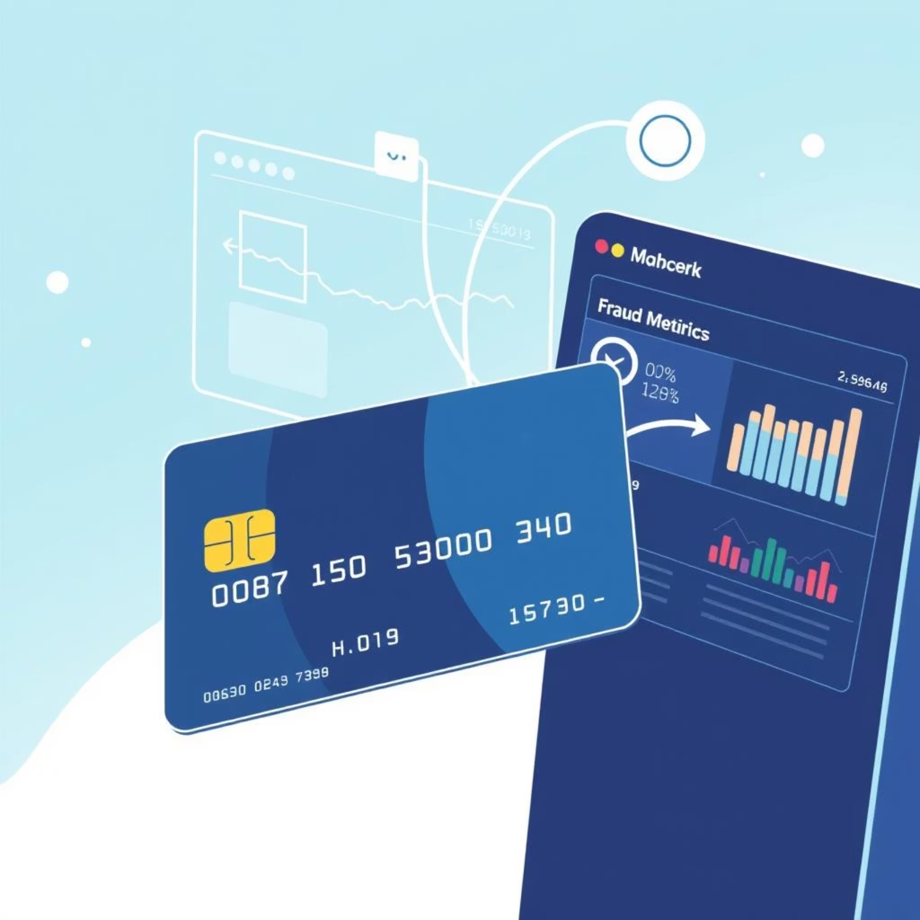
Case Study: Fraud Detection in Electricity and Gas Consumption Challenge
The Tunisian Company of Electricity and Gas (STEG) is a public and a non-administrative company, it is responsible for delivering electricity and gas across Tunisia. The company suffered tremendous losses in the order of 200 million Tunisian Dinars due to fraudulent manipulations of meters by consumers.
Using the client’s billing history, the aim of the challenge is to detect and recognize clients involved in fraudulent activities.
The solution will enhance the company’s revenues and reduce the losses caused by such fraudulent activities.
source: https://zindi.africa/competitions/fraud-detection-in-electricity-and-gas-consumption-challenge

Slide 12
Recommendations & Insights: Data-Driven Suggestions
Prioritize High-Risk Accounts for Inspection
Use model risk scores to focus field audits and investigations on accounts most likely to commit fraud, optimizing resource allocation.
Implement Real-Time Consumption Monitoring
Deploy automated systems to flag and alert unusual or suspicious usage patterns as they happen, enabling quick intervention.
Enhance Customer Verification Processes
Strengthen onboarding and periodic re-verification for customer segments or meter types with elevated fraud risk.
Develop Fraud Awareness Campaigns
Launch educational initiatives targeting high-risk groups to inform them about fraud consequences and promote honest consumption reporting.
Continuously Update the Detection Model
Regularly retrain your fraud detection model with new data and confirmed fraud cases to adapt to evolving fraud tactics and maintain high accuracy.

Slide 13
Acknowledgments
This project is part of the Zindi Fraud Detection Challenge, in partnership with STEG.

Slide 14
Thank You / Q&A
Contact Information: angenoella1771@gmail.com
Github repository link: https://github.com/DeNoella/zindi-utility-fraud-detection
Dataset link: https://zindi.africa/competitions/fraud-detection-in-electricity-and-gas-consumption-challenge

